Slide 1
RESEARCH AND DESIGN OF CRYPTOGRAPHY CLOUD FRAMEWORK

Slide 2
ABSTRACT
Since the application mode of cryptography technology currently has different types in the cloud environment, a novel cryptography cloud framework was proposed, due to the non-expandability of cryptography resources. Through researching on the application models of the current encryption technology, the cryptography service demand under the cloud environment and the virtual structure of the cloud cryptography machine, this paper designed the framework of the cryptography cloud framework that provides cryptography services with the cloud computing mode. the design idea of the framework is expounded from two aspects include the function of modules and service flow of cryptography cloud, which resulted in the improvement of the flexibility of the application of cryptography technology in the cloud environment. Through the analysis of system function and management mode, it illustrated the availability and security of cryptography cloud framework. It was proved that cryptography cloud has the characteristics of high-availability in the implementation and experiment, and it can satisfy cryptography service demand in the cloud environment.

Slide 3
EXISTING SYSTEM | PROPOSED SYSTEM
EXISTING CONCEPT:- The illegal user accesses their own key information according to their requirements, but trust of the third party can’t be measured objectively, so there are still existing security risks to a certain extent. The application mode of cryptography technology currently has different types in the cloud environment, a novel cryptography cloud framework was proposed, due to the non-expandability of cryptography resources. | PROPOSED CONCEPT: • It designed the framework of the cryptography cloud framework that provides cryptography services with the cloud computing mode. • It was proved that cryptography cloud has the characteristics of high-availability in the implementation and experiment, and it can satisfy cryptography service demand in the cloud environment

Slide 4
EXISTING SYSTEM | PROPOSED SYSTEM
EXISTING TECHNIQUE:- FHE Algorithm. | PROPOSED TECHNIQUE:- Cryptography Algorithm.
TECHNIQUE DEFINITION:- • It is the enhanced version of Fast Random Bit Encryption. • After compression, the compressed data is converted into frames before encryption is applied | TECHNIQUE DEFINITION:- Decryption is the reverse, in other words, moving from the unintelligible ciphertext back to plaintext. • A cipher (or cypher) is a pair of algorithms that create the encryption and the reversing decryption. The detailed operation of a cipher is controlled both by the algorithm and in each instance by a "key".

Slide 5
EXISTING SYSTEM | PROPOSED SYSTEM
DRAWBACKS:- It is very difficult or impossible to learn. • The data loss is high. | ADVANTAGES:- Symmetric cryptography uses the same key to both encrypt and decrypt information. That implies that both sender and receiver must possess the same key. Symmetric cryptography provided a great advantage over normal forms of communication but posed some new problems.

Slide 6
MINIUM SYSTEM REQUIREMENTS
HARDWARE
PROCESSOR : DUAL CORE 2 DUOS.
RAM : 2GB MB DD RAM
HARD DISK : 250 GB
SOFTWARE
FRONT END : JAVA (J2EE, SERVLETS, JSP)
BACK END : MY SQL
OPERATING SYSTEM : WINDOWS 07
IDE : ECLIPSE

Slide 7
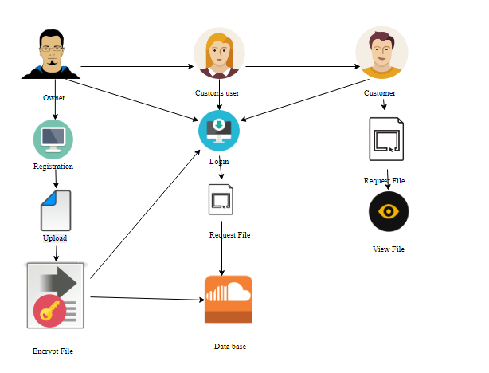

Slide 8
PRPOSED SYSTEM | FUTURE ENHANCEMENT
PROPOSED CONCEPT:- It designed the framework of the cryptography cloud framework that provides cryptography services with the cloud computing mode. It was proved that cryptography cloud has the characteristics of high-availability in the implementation and experiment, and it can satisfy cryptography service demand in the cloud environment. | FUTURE CONCEPT : - Cryptography is important because it is what prevents criminals from stealing your information online. When you see a website with HTTPS protocol enabled, that is cryptography at work. It is also at work when you log onto a wifi hotspot or encrypt a file.

Slide 9
PROPOSED SYSTEM | FUTURE ENHANCEMENT
PROPOSED TECHNIQUE: - Cryptography Algorithm . | FUTURE TECHNIQUE: - Quantum Cryptography
TECHNIQUE DEFINITION:- Decryption is the reverse, in other words, moving from the unintelligible ciphertext back to plaintext. A cipher (or cypher) is a pair of algorithms that create the encryption and the reversing decryption. The detailed operation of a cipher is controlled both by the algorithm and in each instance by a "key". | TECHNIQUE DEFINITION:- In the history of cryptography, quantum cryptography is a new and important chapter. It is a recent technique that can be used to ensure the confidentiality of information transmitted between two parties, usually called Alice and Bob, by exploiting the counterintuitive behavior of elementary particles such as photons.

Slide 10
PRPOSED SYSTEM | FUTURE ENHANCEMENT
ADVANTAGES: Symmetric cryptography uses the same key to both encrypt and decrypt information. That implies that both sender and receiver must possess the same key. Symmetric cryptography provided a great advantage over normal forms of communication but posed some new problems. | EXTRAVAGANCE:- It can be used to ensure the confidentiality of information transmitted between two parties.

Slide 11
THANK YOU

